Slide 1
Database management system (DBMS) Architecture and Concepts
Abylkassymova A.B.

Slide 2
Introdution
DBMS – Database Management System
DBMS is a software system for creating, organizing and managing the database.
It provides an environment to the user to perform operations on the database for creation, insertion, deletion, updating and retrieval of data.

Slide 3
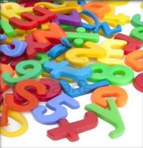
What is data?
A collection of raw facts and figures.
Raw material that can be processed by any computing machine.
A collection of facts from which conclusions may be drawn.
Data can be represented in the form of numbers and words which can be stored in computer’s language. i.e. Arman, 0.001, 5.

Slide 4

What is Information?
Symptomatic meaningful form of data.
Knowledge acquired through study of experience.
Information helps human begins in their decision making.

Slide 5

Database
A safekeeping of logically related and similar data.
An organized collection of related information so that it can be easily accessed, managed and updated.
E.g.:
Dictionary
Airline Database
Student Database
Library
Railways Timetable
YouTube

Slide 6
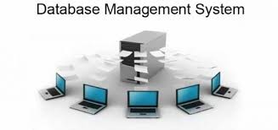
What is DBMS?
A set of programs to access the interrelated data
DBMS contains information about a particular enterprise.
Computerized record keeping system
Provides convenient environment to user to perform operations:
- Creation, Insertion, Deletion, Updating & Retrieval of Information.

Slide 7
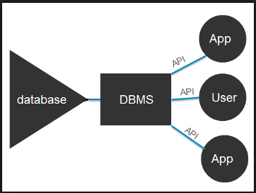
Vizualization

Slide 8
Objectives of DBMS
Data availability-The data availability is responsible for the cost performance and the query update. Availability functions make the database available to users helps in defining and creating a database and getting the data in and out of a database.
Data integrity-The data integrity provides protection for the existence of the database and maintaining the quality of the database.
Data independence- DBMS provides two types of data independences. First is a physical data independence program, which remains unaffected from the changes in the storage structure or access method, and the second is the logical data independence program, which remains unaffected from the changes in the schema.

Slide 9
ACID Properties
ACID properties are an important concept for databases.
The acronym stands for Atomicity, Consistency, Isolation, and Durability.
The ACID properties of a DBMS allow safe sharing of data.
Without these ACID properties, everyday occurrences such using computer systems to buy products would be difficult and the potential for inaccuracy would be huge.
The following basic concepts are used in database management systems (DBMS)
Atomicity
Consistency
Isolation
Durability

Slide 10
Atomicity
The first ACID property is atomicity. When an update occurs to a database, either all or none of the update becomes available to anyone beyond the user or application performing the update. This update to the database is called a transaction and it either commits or aborts. This means that only a fragment of the update cannot be placed into the database, should a problem occur with either the hardware or the software involved.
Features to consider for atomicity
It is maintained in the presence of deadlocks.
It is maintained in the presence of database software failures.
It is maintained in the presence of application software failures.
It is maintained in the presence of CPU failures.
It can be turned off at the system level.
It can be turned off at the session level.

Slide 11
Others
Consistency
Consistency is the ACID property that ensures that any changes to values in an instance are consistent with changes to other values in the same instance. A consistency constraint is a predicate on data which serves as a precondition, post-condition, and transformation condition on any transaction.
Isolation
The isolation portion of the ACID Properties is needed when there are concurrent transactions. Concurrent transactions are transactions that occur at the same time, such as shared multiple users accessing shared objects.
Durability
Maintaining updates of committed transactions is critical. These updates must never be lost. The ACID property of durability addresses this need. Durability refers to the ability of the system to recover committed transaction updates if either the system or the storage media fails.
Features to consider for durability
Recovery to the most recent successful commit after an application software failure.
Recovery to the most recent successful backup after a disk failure.
Recovery to the most recent successful commit after a CPU failure.
Recovery to the most recent successful commit after a data disk failure.
Recovery to the most recent successful backup after a disk failure.

Slide 12
More about DBMS
A database management system receives instruction from a database administrator (DBA) and accordingly instructs the system to make the necessary changes. These commands can be to load, retrieve or modify existing data from the system.
A DBMS always provides data independence. Any change in storage mechanism and formats are performed without modifying the entire application. There are four main types of database organization….

Slide 13
Relational Database
Data is organized as logically independent tables.
Relationships among tables are shown through shared data.
The data in one table may reference similar data in other tables, which maintains the integrity of the links among them.
This feature is referred to as referential integrity – an important concept in a relational database system.
Operations such as "select" and "join" can be performed on these tables. This is the most widely used system of database organization.

Slide 14
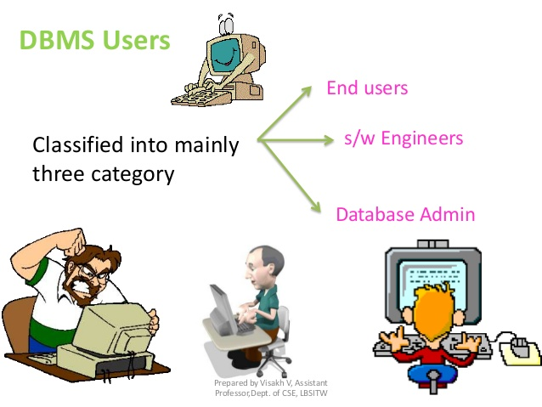
Database Users
Database users and user interfaces
Native Users
Casual End Users
Application Programmers
Sophisticated Users
Specialized Users

Slide 15
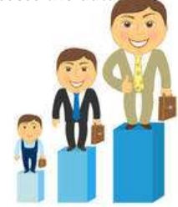
Casual End Users
Access data base occasionally when needed
They need different information each time
They use sophisticated query language to specify their request
Example: High Level Managers who access the data weekly or biweekly.

Slide 16
Native Users (parametric)
They make up a large section of the database
They communicate with the database on regular period
Communicate with the system by invoking one of the applications programs that have been written previously
Their job is constantly querying and updating database using standard queries
This is called canned transaction
Ex.: Bank teller, reservation clerks,…

Slide 17
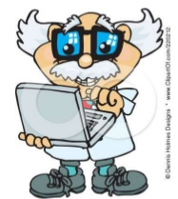
Sophisticated Users
They include business analyst, scientist, engineers, other thoroughly familiar with the system capability
They interact with the system without writing programs, instead they form their requests in a database query language
They submit each query to a query processor.
Its function is to break down DML statements
Into instructions that the storage manager can understand

Slide 18
Specialized Users
Also Sophisticated users who write specialized database applications that do not fit into traditional data processing framework
Write specialized applications like CAD (Computer Aided Design), Multimedia database programs

Slide 19
Application Programmers
Write database programs in some programming languages (COBOL, C++ or other forth generation languages)
Access database by issuing the appropriate request to the DBMS

Slide 20
Database Administrator
The DBA can be a single person or a tem comprising a group of persons
The functions of DBA include:
Definition of the Conceptual Schema
Definition of Internal Schema
Liaising with users
Granting of authorization for data access
Defining integrity constraints

Slide 21
Schemas versus Instances
Database Schema:
The description of a database.
Includes descriptions of the database structure, data types, and the constraints on the database.
Schema Diagram:
An illustrative display of (most aspects of) a database schema.
Schema Construct:
A component of the schema or an object within the schema, e.g., STUDENT, COURSE.

Slide 22
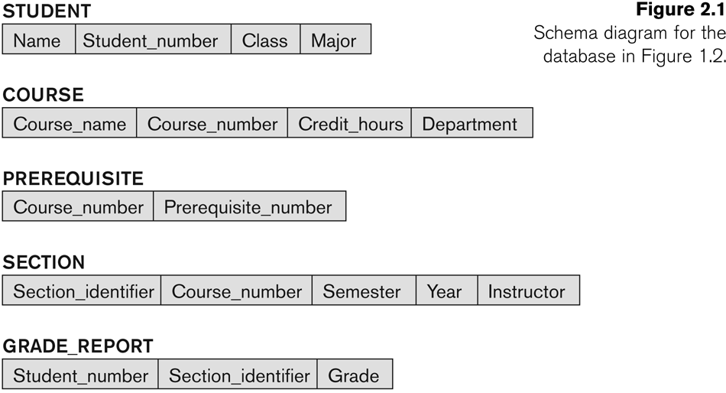
Example of a Database Schema

Slide 23
Schemas versus Instances
Database State:
The actual data stored in a database at a particular moment in time. This includes the collection of all the data in the database.
Also called database instance (or occurrence or snapshot).
The term instance is also applied to individual database components, e.g. record instance, table instance, entity instance

Slide 24
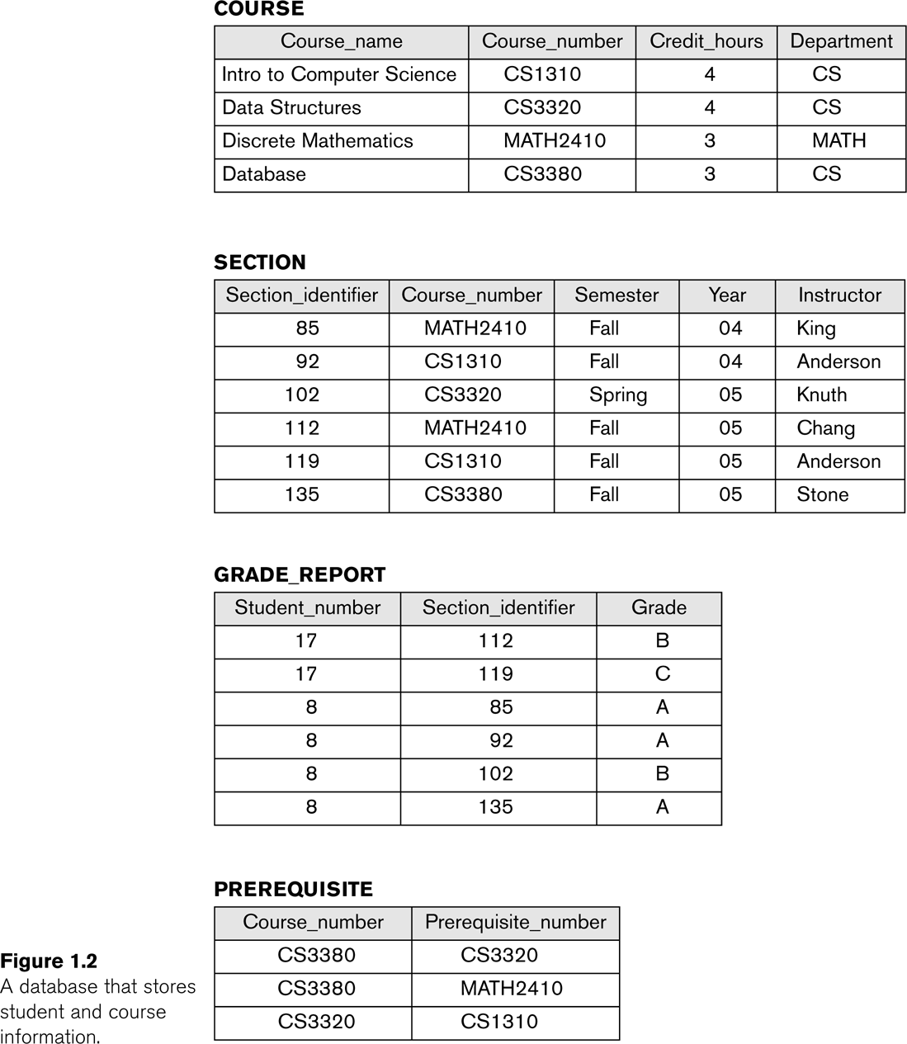
Example of a database state

Slide 25
Database Schema vs. Database State
Database State:
Refers to the content of a database at a moment in time.
Initial Database State:
Refers to the database state when it is initially loaded into the system.
Valid State:
A state that satisfies the structure and constraints of the database.

Slide 26
Database Schema vs. Database State (continued)
Distinction
The database schema changes very infrequently.
The database state changes every time the database is updated.

Slide 27
Data Base Languages
A database system provides two different types of Languages, one will specify the schema, and other will express database queries and updates.
They are:
1. Data-Definition Languages (DDL)
2. Data-Manipulation Language (DML)
3. Data-Control Language (DCL)

Slide 28
Data-Definition Languages (DDL)
A database scheme is specified by set of definitions which are expressed by special language called Data Definition Language (DDL). The result of compilation of DDL statements is a set of tables that is stored in a special file called ‘Data dictionary’ or “data directory.
A data dictionary is a file that contains metadata, i.e. Data about data.
This file is consulted before actual data are read or modified in the database system
The storage structure and access methods used by the database system are specified by a set of definitions in a special type of DDL called a ‘data storage and data definition language’. The result of consultation of these definitions is a set instruction to specify the implementation details of the database schemas. Which are usually hidden form the users.
The DDL commands are

Slide 29
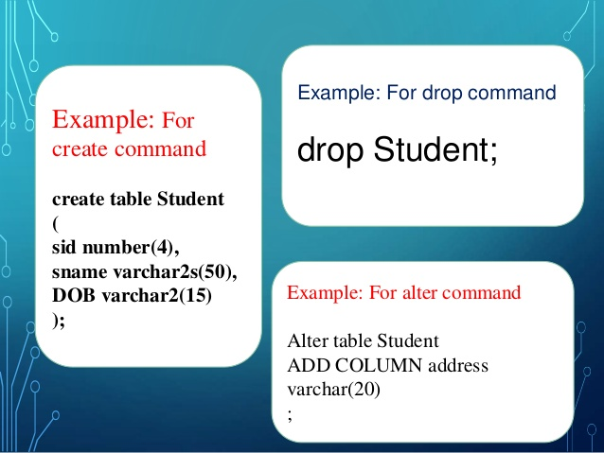
Example

Slide 30
Data-Manipulation Language (DML)
A DML is language which enables users to access or manipulate data as organized by appropriate data model. The goal is to provide efficient human interaction with the system.
The DML allows following
(a) The retrieval information form the database
(b) The Insertion of new information in to existing database
(c) The deletion of existing information from database
(d) The modification of information stored in the database.
A DML is language which enables users to access or manipulate data.
There are basically two types.
Procedural DML : This requires a user to specify what data are needed and how to get those data from existing database.
Non procedural DML :
Which require a user to specify what data are needed ‘without’ specifying how to get those data.
Nonprocedural DMLs are usually easier to learn and use than procedural DMLs. A user does not have to specify how to the data, these languages may generate code that is not as that produced by Procedural DML. Hence we can make remedy this difficulty by various optimization techniques.
A Query is a statement, a request for retrieval information. The portion of a DML, that involves information retrieval is called a ‘Query Language’.

Slide 31
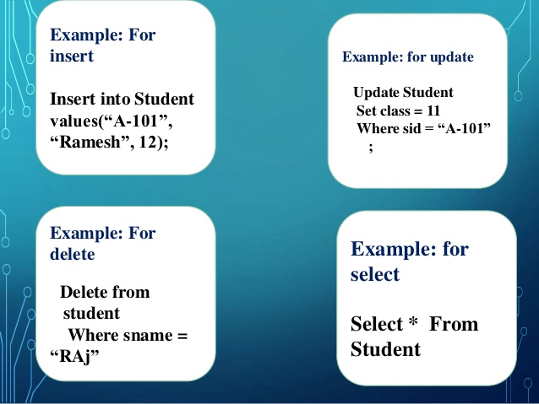
Example

Slide 32
Data-Control Language (DCL)
DCL statements control access to data and the database using such as GRANT and REVOKE.
A privilege can either be granted to a User with the help of GRANT statement.
The privileges assigned can be SELECT, ALTER, DELETE, EXECUTE, INSERT, INDEX, etc.
In addition to granting of privileges, you can also revoke (take back) it by using REVOKE command.

Slide 33
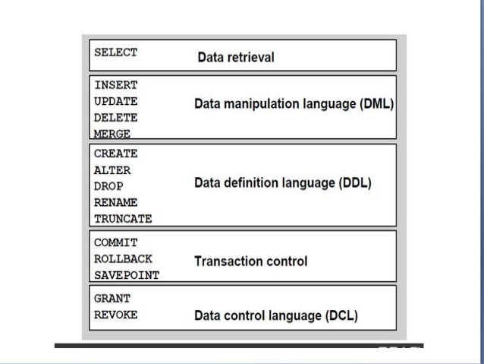
Conclusion

Slide 34
Three Levels of Architecture
Three level architecture is also called ANSI/SPARC architecture or three schema architecture
This framework is used for describing the structure of specific database systems (small systems may not support all aspects of the architecture)
In this architecture the database schemas can be defined at three levels explained in next slides…

Slide 35
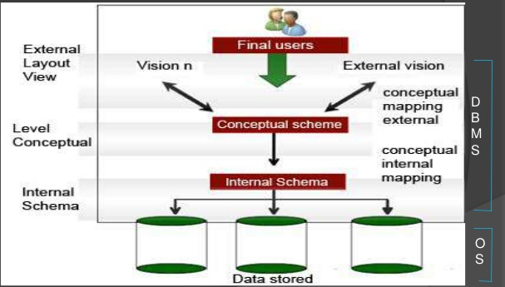
Three levels of Architecture

Slide 36
External View
Highest or Top level of data abstraction (No knowledge of DBMS or physical storage).
This level is concerned with the user.
Each external schema describes the part of the database that a particular user is interested in and hides the rest of database from the user.
There can be a n number of external views for database where n is the number of users.
Ex., an account department may only be interested in the student fee details. It would not be expected to have any interest in the personal information about students.
All database users work on external level of DBMS.

Slide 37
Conceptual View
This level is in between the user level and physical storage view.
There is only one conceptual view for single database.
It hides the details of physical storage structure and concentrates on describing entities, data types, relations, user operations, and constraints.

Slide 38
Internal View
It is lowest level of data abstraction. (It has the knowledge about database)
At this level it keeps the information about actual representation of the entire database i.e. the actual storage of the data on the disk in the form of records or blocks.
It is close to physical storage method.
The internal view is the view that tells us what data is stored in the database and how. At least the following aspects are considered at this level: Storage allocation, Access paths etc.
The internal view does not deal with the physical devices directly. Instead it views a physical device as a collection of physical pages and allocates space in terms of logical pages.

Slide 39
Three levels of Architecture (cont…)
Internal/physical level: Shows how data are stored inside the system. It is the closest level to the physical storage. This level talks about database implementation and describes such things as file organization and access paths of indexes, data compressions and encryption techniques, and record placement
Conceptual/logical level: Deals with the modeling of the whole database. The conceptual schema of the database is defined in this level
External level: This level models a user oriented description of the part of the database. The views for individual users are defined by means of external schemas in this level

Slide 40
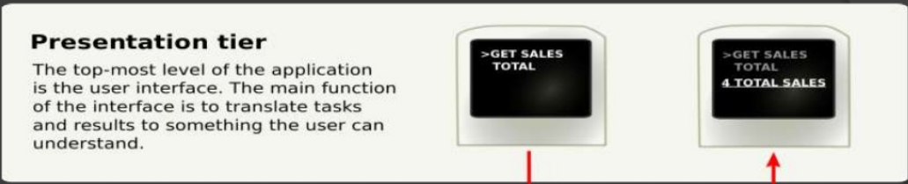
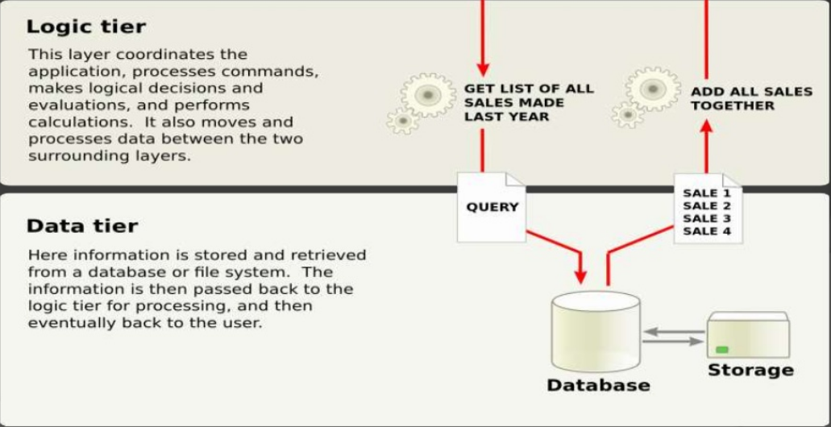
Working of the three level architecture

Slide 41

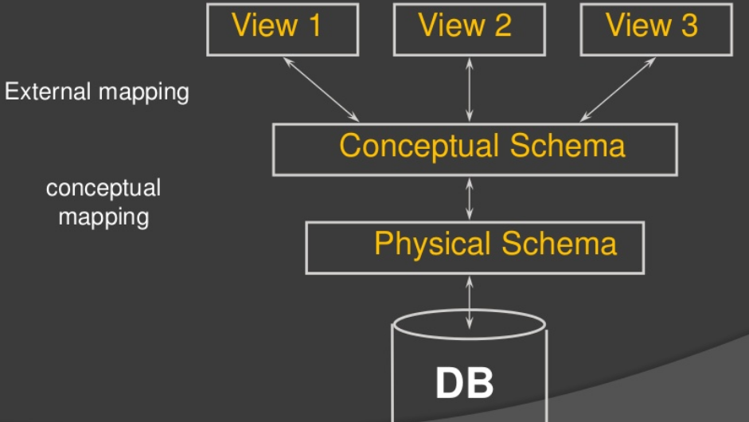
Levels of DBMS Architecture

Slide 42
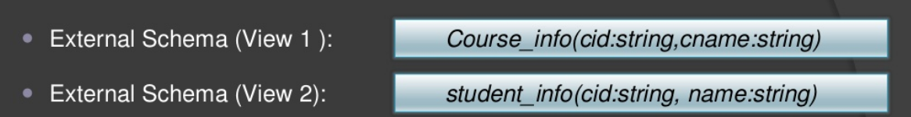
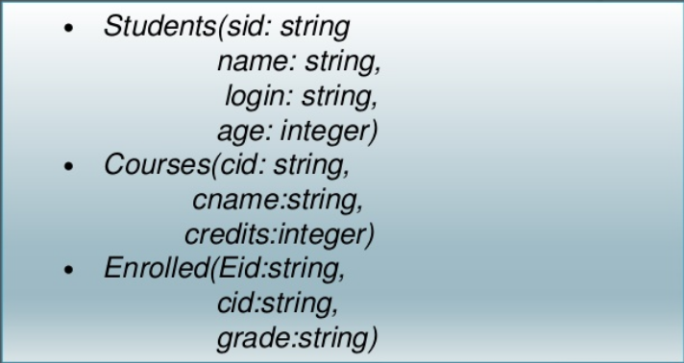

Example: University Database
Conceptual schema:
Physical schema:

Slide 43
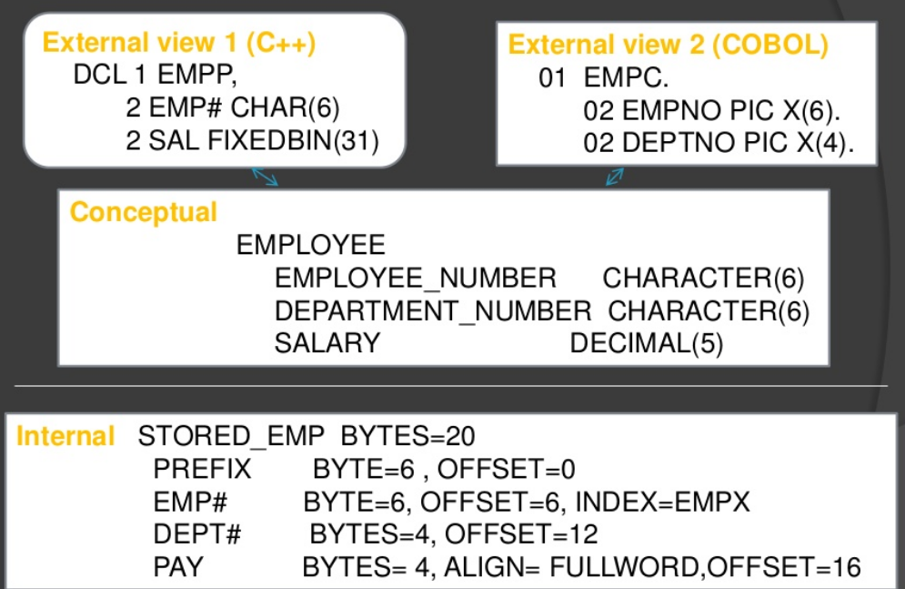
Example: Employee Database

Slide 44
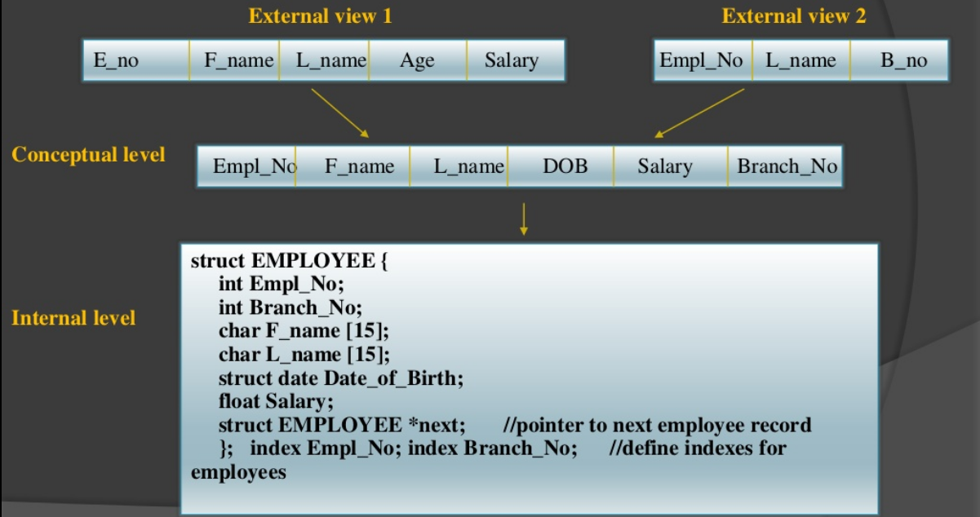
Syntax Example

Slide 45
The Three level Architecture
Each user should be able to access the same data but have a different customize view of the data
User should not have to deal directly with physical database storage detail.
The DBA should be able to change the database storage structure without affecting the users views.
The internal structure of the database should be unaffected by changes to the physical aspects of storage.
The DBA should be able to change the conceptual structure of the database without affecting all users.

Slide 46
Other types
Flat Database:
Data is organized in a single kind of record with a fixed number of fields.
This database type encounters more errors due to the repetitive nature of data.
Object-Oriented Database:
Data is organized with similarity to object-oriented programming concepts.
An object consists of data and methods, while classes group objects having similar data and methods.
Hierarchical Database:
Data is organized with hierarchical relationships.
It becomes a complex network if the one-to-many relationship is violated.

Slide 47
MetaData

Slide 48
What is Metadata and what's its purpose?
Metadata is by definition "data about other data" of any type and sort in any media.
It is used to facilitate the understanding, characteristics and management usage of data.
For effective data management, the Metadata should include data that is coherent with the context of use.

Slide 49
Role
This Metadata is used for better access to the enormous amounts of data stored and managed by different companies.
Metadata provides context for data.
In data processing, for example, Metadata is definitional, it gives documentation of other data in the application or environment.
The term "Metadata" should be used carefully since all data is about something and hence is "Metadata"

Slide 50
Importance
In Databases, Metadata defines data elements and attributes (Name, data type, size, etc), data could be registered about structures and records as well (Length, columns and fields).
This is extremely helpful for the reliability of databases and their efficiency.
In a library, for example, the data is the content of the titles, and the Metadata is about the title, the author,a description of the content, the physical location and the date of publication.
In addition, it protects investment in data, helps the user in understanding data,enables discovery options, and limits Liability.
All of these reasons, make Metadata the backbone in understanding a DBMS

Slide 51
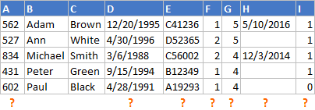

Why Is Metadata Important for Databases?
Let's consider the following example - we were asked to list all current employees with all the available details.
Let's assume we found this raw table of data:

Slide 52
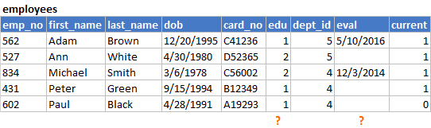
Basic Metadata
This metadata - tables and column names - are a standard element of all modern database systems. But those names might not tell us what the table holds for various reasons:
Names are vague or confusing
Column might have changed its purpose without changing its name
A short name might not be enough to explain complex logic
We need much more metadata - we need a Data Dictionary.

Slide 53
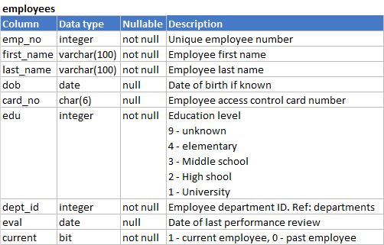
Data Dictionary
That explains a lot: we now know how to get a specific department - we need to use the departments lookup table, we know how to decipher education - there seems to be no lookup table and the logic is a bit confusing and we know that the eval column holds the date of the last employee performance review date.

Slide 54
Conclusion
This was a simple example of a small single table.
Real databases hold many, many more tables that have many, many more columns.
Level of difficulty is much higher.
If you want to be able to use your data effectively you need to take care of meaningful metadata.
Without Metadata you can't use your data!

